Slide 1

Skin Disorder prediction
SALMAN FARIS C P

Slide 2

DOMAIN HEALTH CARE

Slide 3

CONTEXT
This database contains 34 attributes, 33 of which are linear valued and one of them is nominal.The differential diagnosis of erythemato-squamous diseases is a real problem in dermatology. They all share the clinical features of erythema and scaling, with very little differences. The diseases in this group are psoriasis, seboreic dermatitis, lichen planus, pityriasis rosea, cronic dermatitis, and pityriasis rubra pilaris. Usually a biopsy is necessary for the diagnosis but unfortunately these diseases share many histopathological features as well. Another difficulty for the differential diagnosis is that a disease may show the features of another disease at the beginning stage and may have the characteristic features at the following stages. Patients were first evaluated clinically with 12 features. Afterwards, skin samples were taken for the evaluation of 22 histopathological features. The values of the histopathological features are determined by an analysis of the samples under a microscope.In the dataset constructed for this domain, the family history feature has the value 1 if any of these diseases has been observed in the family, and 0 otherwise. The age feature simply represents the age of the patient. Every other feature (clinical and histopathological) was given a degree in the range of 0 to 3. Here, 0 indicates that the feature was not present, 3 indicates the largest amount possible, and 1, 2 indicate the relative intermediate values.The names and id numbers of the patients were recently removed from the database.

Slide 4
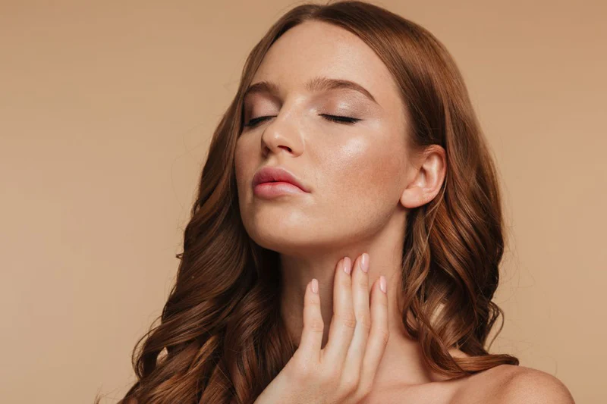
CLASSES & DISEASES
1 - psoriasis
2 - seboreic dermatitis
3 - lichen planus
4 - pityriasis rosea
5 - cronic dermatitis
6 - pityriasis rubra pilaris.

Slide 5
ATTRIBUTE INFORMATION
Clinical Attributes: (take values 0, 1, 2, 3, unless otherwise indicated)
23: spongiform pustule
24: munro microabcess
25: focal hypergranulosis
26: disappearance of the granular layer
27: vacuolisation and damage of basal layer
28: spongiosis
29: saw-tooth appearance of retes
30: follicular horn plug
31: perifollicular parakeratosis
32: inflammatory monoluclear inflitrate
33: band-like infiltrate
34: Age (linear)
1: erythema
2: scaling
3: definite borders
4: itching
5: koebner phenomenon
6: polygonal papules
7: follicular papules
8: oral mucosal involvement
9: knee and elbow involvement
10: scalp involvement
11: family history, (0 or 1)
12: melanin incontinence
13: eosinophils in the infiltrate
14: PNL infiltrate
15: fibrosis of the papillary dermis
16: exocytosis
17: acanthosis
18: hyperkeratosis
19: parakeratosis
20: clubbing of the rete ridges
21: elongation of the rete ridges
22: thinning of the suprapapillary epidermis

Slide 6
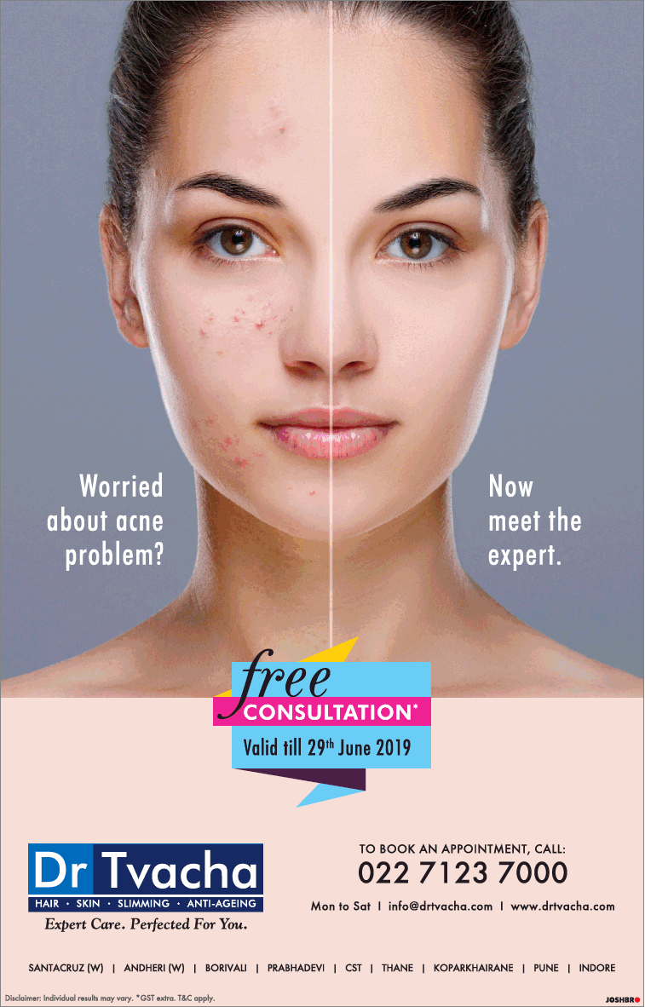
Data Preprocessing
Handled missing values and duplicates
Scaled features (0-3)
Feature encoding if applicable

Slide 7
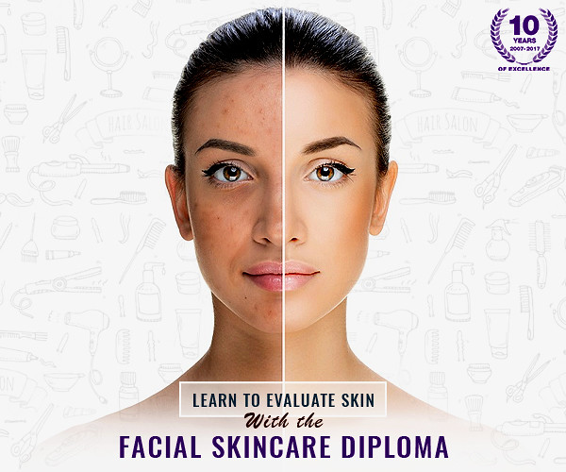
Exploratory Data Analysis (EDA)
Visual insights on class distribution
Correlation between features
Key patterns discovered

Slide 8

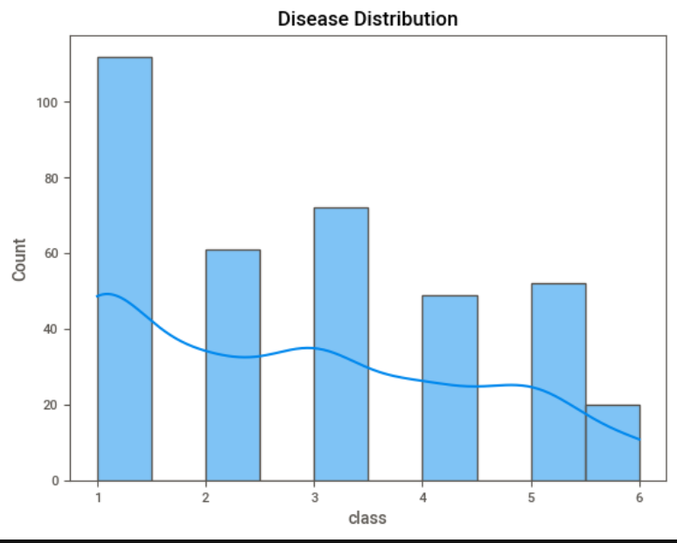
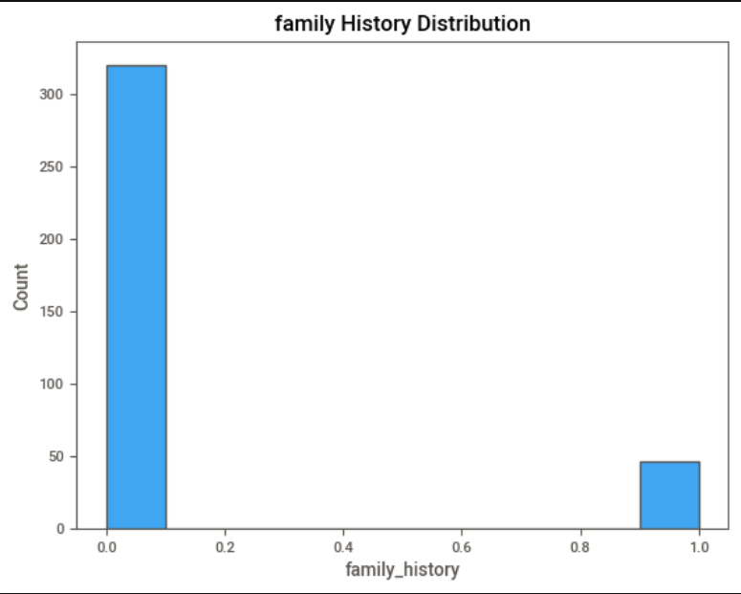
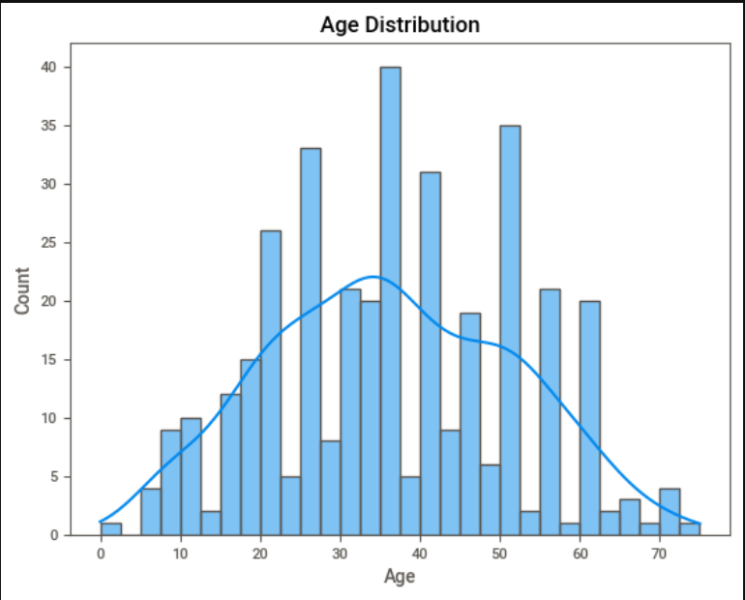

Slide 9
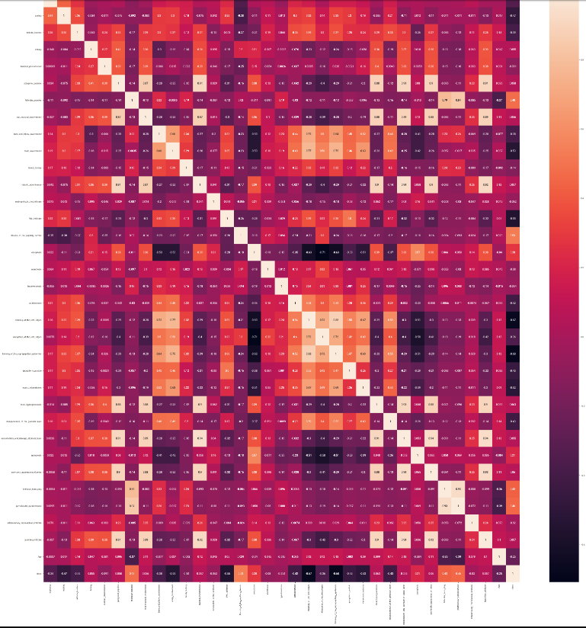
CORRELATION MAP

Slide 10
Model creation

Slide 11
Model Selection and Training
Machine learning algorithms used:
Logistic Regression
Decision Tree
Random Forest
SVM
KNN
GradientBoosting
Training and testing split strategy (e.g., 80/20)

Slide 12
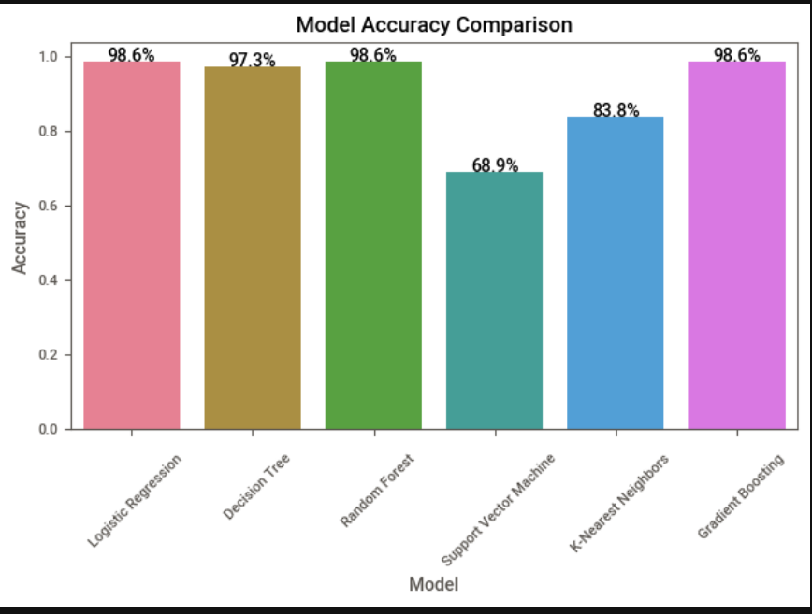
MODEL SELECTION

Slide 13

MODEL SELECTION
"After comparing all models, I chose Logistic Regression as the primary model due to its simplicity, interpretability, and comparable performance to more complex models. It also generalized well on the test data without signs of overfitting."

Slide 14
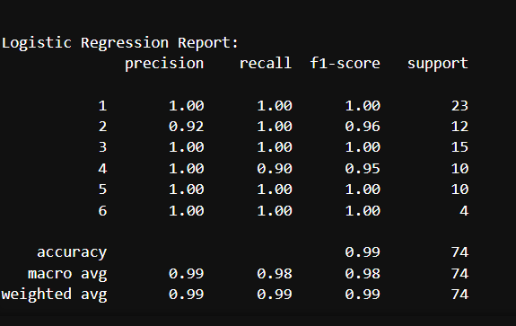
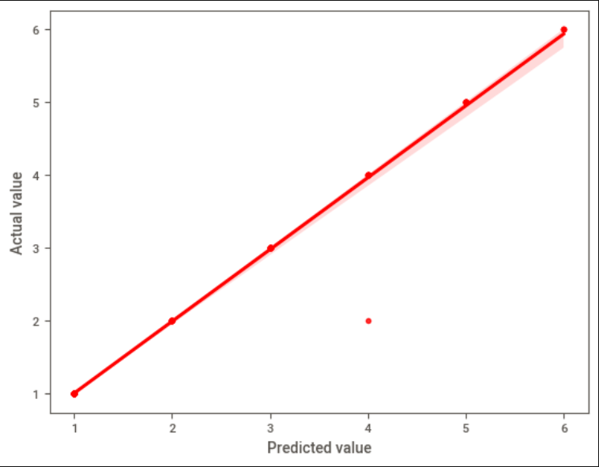
LOGISTIC REGRESSION

Slide 15
DEPLOYMENT CLICK HERE

Slide 16
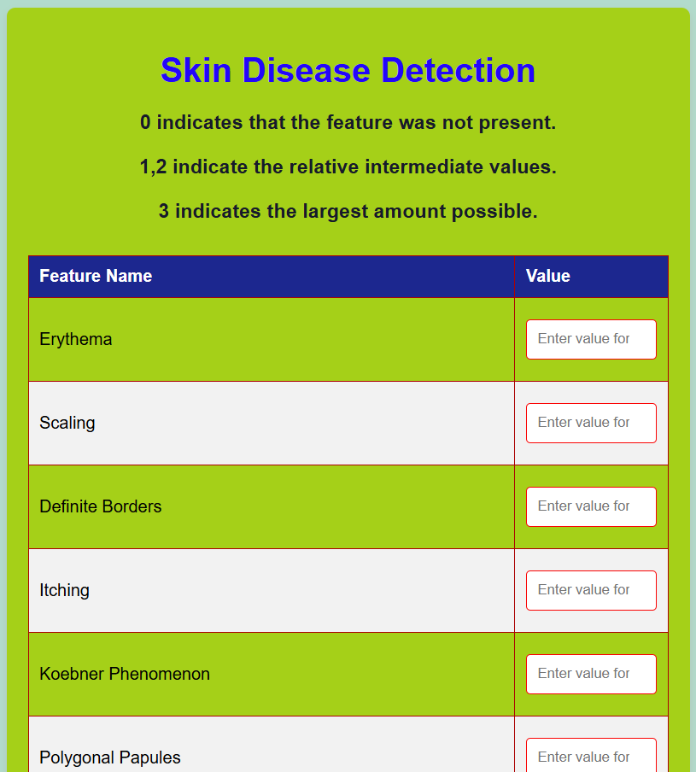
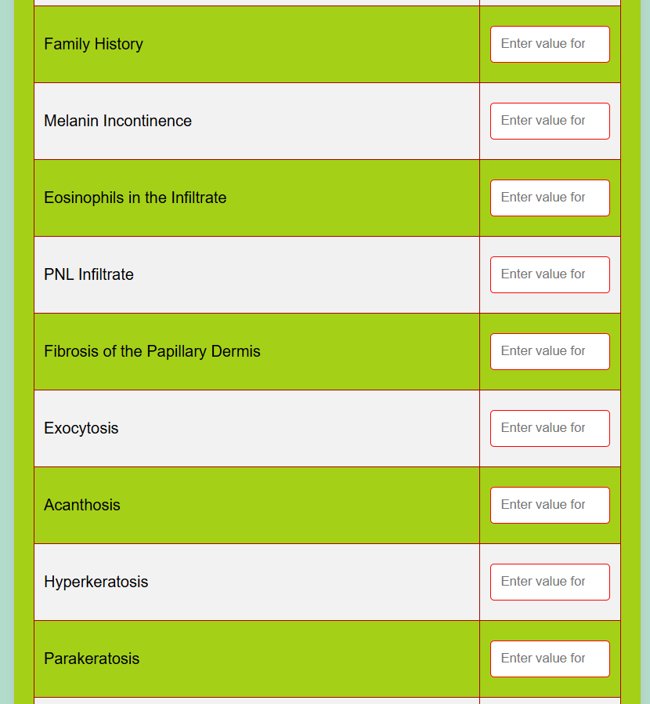
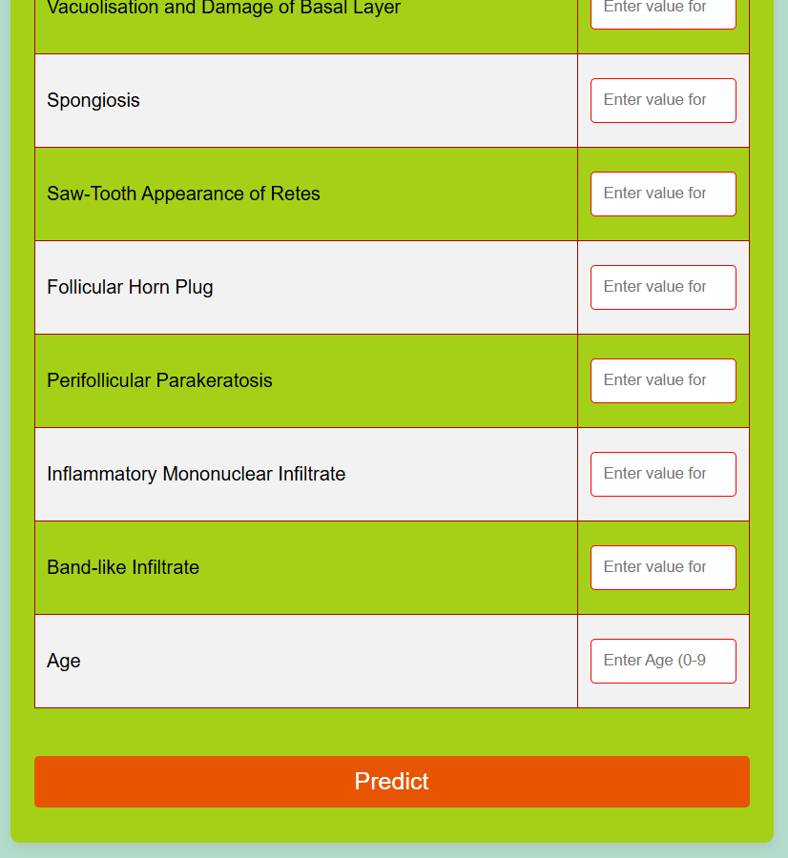

Slide 17
Challenges Faced
"Some key challenges included data imbalance and the similarity between classes. To address these, I explored resampling techniques and regularization methods. Another challenge was potential data leakage, which was controlled by careful train-test splitting and feature handling."

Slide 18
Conclusion
"In summary, this project developed a machine learning-based solution for skin disorder prediction using a dataset with 34 attributes. Logistic Regression was chosen for its balance between performance and simplicity. The model can aid in early diagnosis and reduce the need for invasive procedures like biopsies."

Slide 19
THANK YOU

